Slide 1


FINANCIAL PERFORMANCE OVERVIEW REPORT
FOR AUGUSTA & CO RETAILS
JANUARY 2013 – DECEMBER 2014
PRESENTED BY:
RICHARD GILBERT
DECEMBER 21, 2023

Slide 2
CONTENTSS
01
Executive Summary.
02
Key findings/solutions(In bullet points).
03
Reccomendations(based on the solutions).
04
Conclusion.

Slide 3
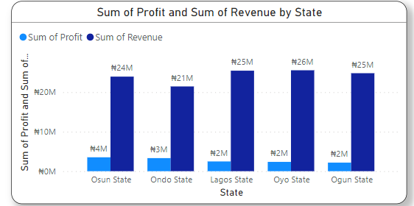
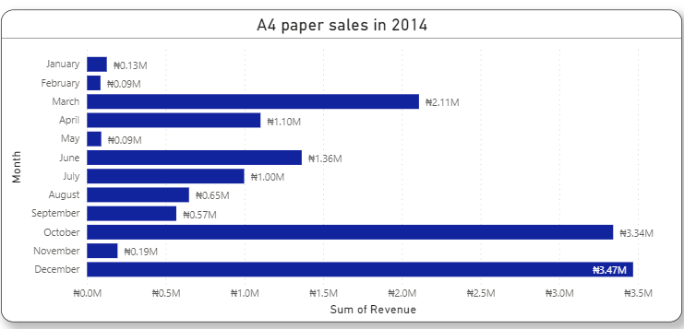
KEY FINDINGS
1. Product Mix and Profitability in Oyo State:
Despite contributing the most to total revenue, Oyo State lacks profitability proportionate to its sales. This is attributed to a product mix that may not align with high-profit items.
2. Surge in A4 Paper Sales (December 2014):
A substantial increase in A4 paper sales during December 2014 indicates a notable market demand. Understanding the factors behind this surge can inform successful strategies for other products or periods.

Slide 4
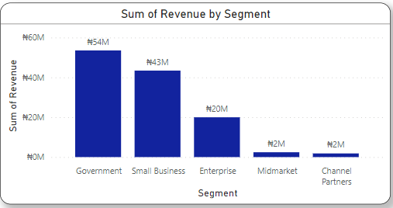
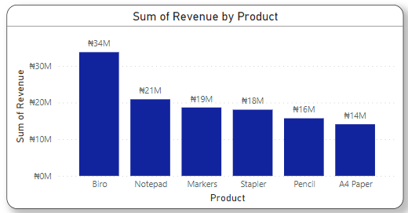
KEY FINDINGS
3. Disparity in Revenue Across Segments:
A significant gap in revenue between the most and least performing segments (54M vs. 2M Naira) highlights the need to explore contributing factors within each segment for more balanced business performance.
4. Biro, Notepad, and Markers as Key Revenue Drivers:
Biro, Notepad, and Markers emerge as pivotal revenue drivers, showcasing their popularity and market demand. Strategic focus on these items can further optimize sales and marketing efforts.

Slide 5
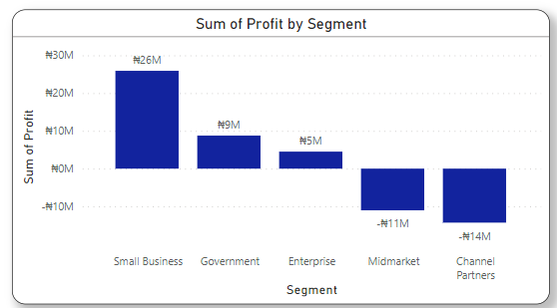
KEY FINDINGS
5. Small Business Segment Leading in Profitability:
The Small Business segment stands out as the most profitable, emphasizing the potential for targeted strategies within this category to enhance overall profitability.

Slide 6
RECOMMENDATIONS
Leverage A4 Paper Success:
Capitalize on the success of A4 paper sales by investigating and replicating the strategies that contributed to the surge in December 2014.
Segment-Specific Strategies:
Develop segment-specific strategies to address the revenue gap between segments, tailoring marketing and product offerings to the unique needs and preferences of each segment.
Strategic Focus on Key Revenue Drivers:
Direct strategic efforts towards Biro, Notepad, and Markers, leveraging their popularity to optimize marketing, inventory management, and potential bundling promotions.

Slide 7
RECOMMENDATIONS
Expand Success in Small Business Segment:
Understand the factors driving profitability in the Small Business segment and explore ways to replicate this success in other segments, fostering a balanced and lucrative business model.

Slide 8
CONCLUSION
In conclusion, our analysis has peeled back layers of insight into the intricacies of product performance, revenue distribution, and segment profitability within our business landscape. The examination of Oyo State's contribution, the surge in A4 paper sales, and the disparities across segments has unearthed critical aspects of our market dynamics.
The prominence of Biro, Notepad, and Markers as revenue drivers and the profitability of the Small Business segment underscore significant areas of strength within our operations. It is evident that these elements play a pivotal role in shaping our financial landscape.
Moreover, the positive trend in profitability from 2013 to 2014 signifies an encouraging trajectory for our business. However, challenges, particularly in aligning profitability with sales in Oyo State and addressing revenue imbalances across segments, demand strategic attention.
By delving into these nuances, we are better equipped to navigate the complex terrain of our market. The imperative now lies in implementing judicious strategies that capitalize on our strengths, address challenges, and chart a course for sustained growth and market responsiveness.
This synthesis of findings not only provides us with a comprehensive understanding of our current standing but also serves as a compass for steering our business towards a future of enhanced performance and profitability.

